Slide 1
XNA workshop
Andrea Magnorsky

Slide 2
XNA game lifecycle
Initialize()
LoadContent()
Update()
UnloadContent()
Draw()
More info http://bit.ly/GLInit
Notes:
Details about initializing http://msdn.microsoft.com/en-us/library/bb203873.aspx
Initialize , init variables, etc that will be set once
Load: called at the start and in case of a device reset
Draw called fixed times per second (default to 60)
Update many times as possible

Slide 3
Graphics Profile
Reach: wide range of devices
HiDef: top of the line hardware
GraphicsAdapter.IsProfileSupported

Slide 4
Blending
Mixes two colours togheter to produce a third one.
With SpriteBatch for the purposes of this class
On Draw, default mode is premultiplied alpha
blend(source, dest) = source.rgb + (dest.rgb * (1 - source.a))

Slide 5
SpriteBatch
Contains methods for drawing groups of sprites into the screen.
Needs a Begin() and End() to Draw
+ Info http://bit.ly/spritebatch
Notes:
More about spritebatch http://gamedev.stackexchange.com/questions/21220/how-exactly-does-xnas-spritebatch-work

Slide 6
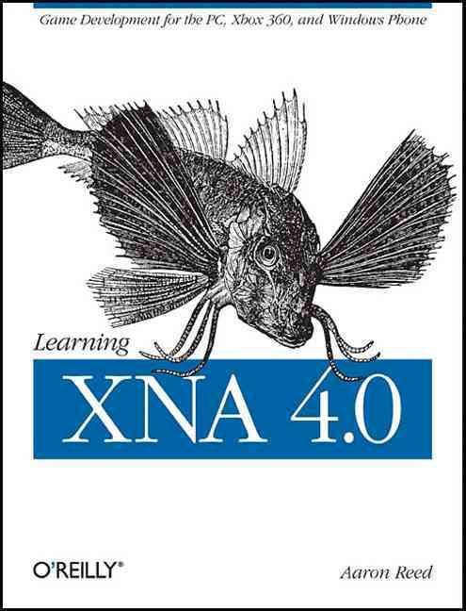
More info in
Chapters 1- 3
Post about premultiplied alpha http://blogs.msdn.com/b/shawnhar/archive/2009/11/06/premultiplied-alpha.aspx
Colour blending http://msdn.microsoft.com/en-us/library/bb976070.aspx
Notes:
Stackexchange Gamedev also have a lot of information

Slide 7
Screen Space
X
Y

Slide 8
Lab 0
Create project
GraphicsDevice -> properties, methods
SpriteBatch
Content Manager, binary files
Game Loop methods
Load Texture
Draw it
Move it
Add font
Draw font
Notes:
Two code files
Possible to have more than one spritebatch per game

Slide 9
Animation
Cell : To cycle through a series of frames (generally in a spritesheet) so that there is apparent movement. Mimics hand drawn animation.
Skeletal: what needs to be animated is represented in two parts. A skin or mesh and a set of bones. Generally used in 3D tho possible (and simpler in 2D)
Procedural: used to automatically generate animation in real-time to allow for a more diverse series of actions than could otherwise be created using predefined animations. Sometimes used to simulate particle systems (smoke, fire, water ), cloth and clothing, rigid body dynamics, and hair and fur dynamics, as well as character animation.

Slide 10
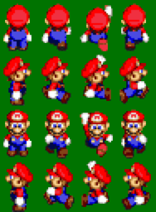
Cell Animation
Given a sprite sheet, loop through the frames to simulate movement.
4 animations
Iterate through all frames.

Slide 11
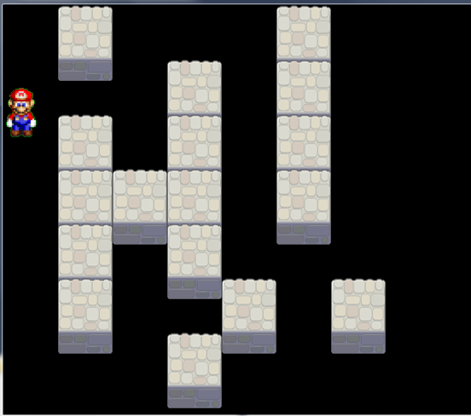
Lab 1

Slide 12
Collision
There are two parts to colision. Collision detection and collision response
Some help from XNA with Rectangle.Intersecs and Rectangle.Reflects
Pretty complete reference http://bit.ly/collisionref

Slide 13
A little bit of trigonometry
Vector: You can imagine this as an arrow to a point in space.
A Vector2D has an X and Y value
Lets watch this http://www.khanacademy.org/math/trigonometry/v/basic-trigonometry

Slide 14
q
Notes:
Screen coordinate space

Slide 15
Framerate Independence
Game works at the same speed even when there is difference how many frames are rendered per second
Use GameTime class to get access to elapsed seconds (elapsedTime.TotalSeconds)

Slide 16
Lab 2
Use vectors
Use trigonometry functions to find direction vectors
Intersect and reflect on Rectangle (Bounding Boxes)
Game Components, DrawableGame Components
Update the position using direction and speed.
Use Rectangle for collision detection and response

Slide 17
Colour Blending
(source * sourceBlendFactor)
blendFunction
(destination*destinationBlendFactor)
http://msdn.microsoft.com/en-us/library/bb976070.aspx

Slide 18
Additive Blending
Doesn’t require an alpha vaue
To combine two colors, we add up their red, green, and blue components to get the resulting color.
Use one of the overloads for SpriteBatch.Begin

Slide 20
f = g + h
g(path) = path cost
h(path) = estimated distance to goal
g
h
Start
Goal

Slide 21
B
75
151
A
140
C
190
118
D
211
E
156
109
101
F
138
G

Slide 22
B
B
f = 75 + 380 = 455
380
75
151
C
f = 140 + 253 = 393
A
140
253
D
f = 118 + 249 = 367
C
190
118
D
211
249
E
156
109
101
F
138
G

Slide 23
B
B
f = 75 + 380 = 455
380
75
151
C
f = 140 + 253 = 393
A
140
253
D
f = 118 + 249 = 367
C
190
118
D
211
249
E
156
109
101
F
138
G

Slide 24
B
F
f = 227 + 97 = 324
75
151
E
f = 329 + 110 = 439
A
140
C
190
118
D
211
110
E
156
109
101
97
F
138
G

Slide 25
B
F
f = 227 + 97 = 324
75
151
E
f = 329 + 110 = 439
A
140
C
190
118
D
211
E
156
109
101
F
138
G

Slide 26
B
E
f = 383 + 110 = 493
75
151
G
f = 365 + 0 = 365
A
140
C
190
118
D
211
110
E
156
109
101
0
F
138
G

Slide 27
B
E
f = 383 + 110 = 493
75
151
G
f = 365 + 0 = 365
A
140
C
190
118
D
211
E
156
109
101
0
F
138
G

Slide 28
380
71
374
151
75
253
366
140
99
176
118
80
193
329
97
211
111
244
100
70
241
146
101
75
138
0
242
120
160

Slide 29
380
71
374
151
75
253
366
140
99
176
118
80
193
329
97
211
111
244
100
70
241
146
101
75
138
0
242
120
160

Slide 30
Does A* always find the lowest cost path?
Yes, always
No, depends on the problem
No, depends on h

Slide 31
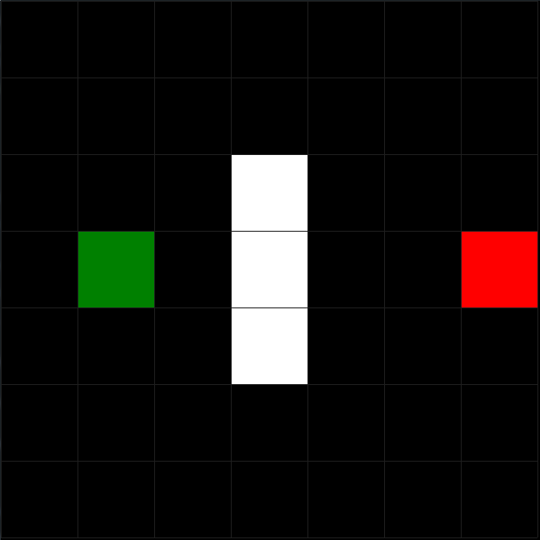

Slide 32
H
F
G
70
60
50
84
70
64
14
10
14
60
40
70
50
10
10
70
60
50
84
70
64
14
10
14

Slide 33
Lab 4 A Star
Implement A star
http://www.gamedev.net/page/resources/_/technical/artificial-intelligence/a-pathfinding-for-beginners-r2003

Slide 34


What is a particle?
A particle typically represents a single component in a particle effect. A single spark in a firework, a single element in a smoke plume, and a single flickering light in a magical effect are all examples of particles.

Slide 35
CPU or GPU bound
Uses the content pipeline to load

Slide 36
Particle Effect
Is a collection
Must be initialized to use

Slide 37
Lab 7 – Particles
Use particles that you have created using Mercury

Slide 38
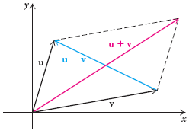
Behaviours
Given u-v vector, we can calculate the distance
Between them

Slide 39
Camera
World is larger than viewport
Simplest camera: follows the player
SpriteBatch begin has an overload that takes transforms:
publicvoid Begin ( SpriteSortMode sortMode, BlendState blendState, SamplerState samplerState, DepthStencilState depthStencilState, RasterizerState rasterizerState, Effect effect, Matrix transformMatrix )
transformMatrixType: Matrix Transformation matrix for scale, rotate, translate options.

Slide 40
public class Camera
{
public Matrix Transform { get; private set; }
public Viewport Viewport { get; private set; }
public Camera(Viewport viewport)
{
Transform = Matrix.Identity;
Viewport = viewport;
}
public void Update(GameTime gameTime, Vector2 position)
{
Transform = Matrix.CreateTranslation(-position.X, -position.Y, 0) *
Matrix.CreateTranslation(Viewport.Width / 2, Viewport.Height / 2, 0)
}
}

